Slide 1

What Metrics Determine Housing Prices? June 12, 2021 Zeray Admasu, Joanne Gates, John-Francis Kraemer, and Sumitha Prabhu
What is the deal with Seattle Housing Prices?
For Discussion Purposes Only

Slide 2
What Metrics Determine Housing Prices?
What metrics determine housing prices in the Seattle metropolitan area? And are they easily available?
Do these metrics have a strong individual correlation to prices or is it strong as a group correlation?
Can these metrics be used to train machine learning methodologies (linear regression, neural networks, decision tree, and random forest) to help predict house prices?
Which machine learning methodologies will provide the most accurate predictions and are they reliable?
Can mean absolute error (MAE), mean square error (RMSE), root mean squared error (MSE) be used to assess the reliability of the best machine learning methodology?

Slide 3
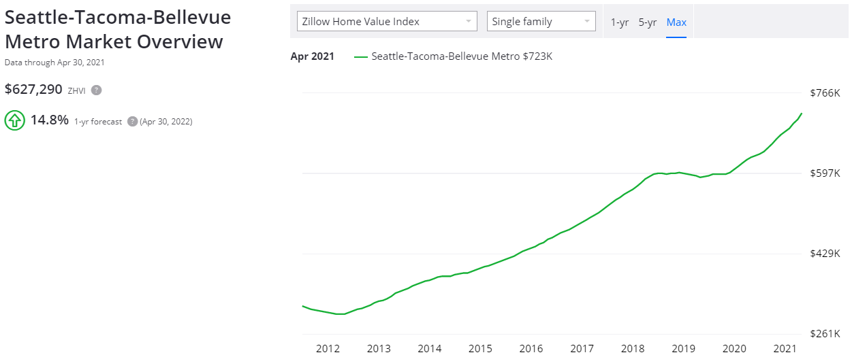
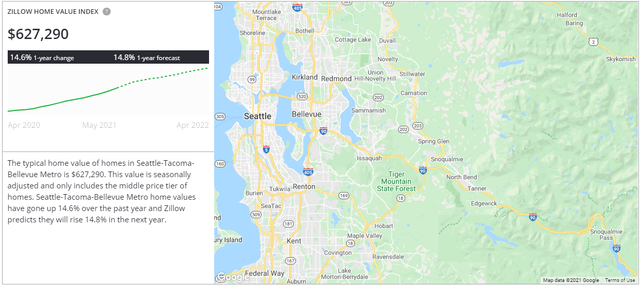
Seattle Housing Prices - Overview
Single family houses increased +14.8% in the past 12 months (Apr-21 vs. Apr-20) and +107.0% (Apr-21 vs. Apr-13)
Source: Zillow (https://www.zillow.com/seattle-tacoma-bellevue-metro-wa_r395078/home-values/)

Slide 4
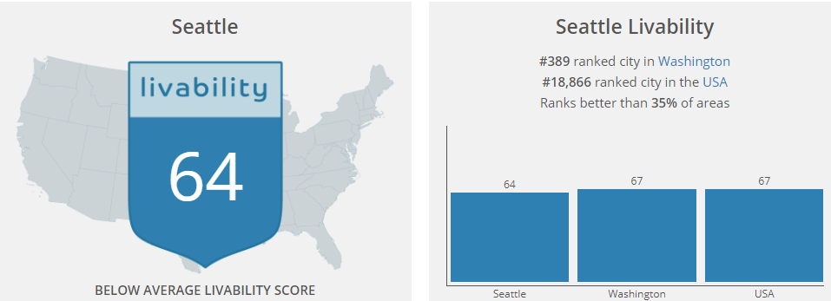
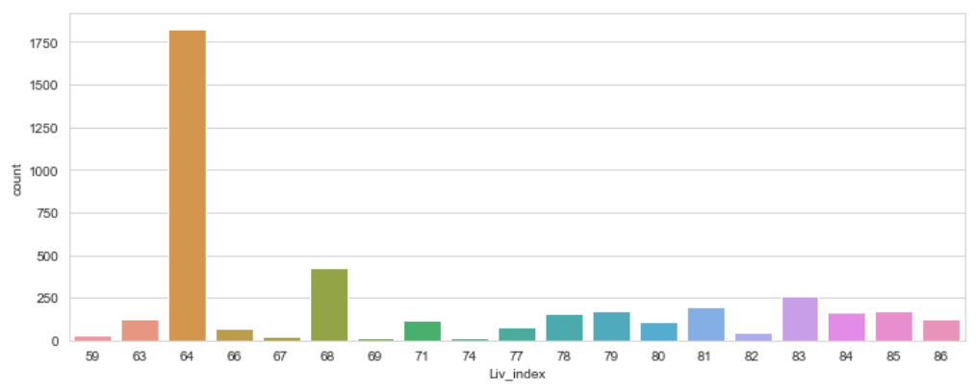
Seattle Housing Prices – Housing Data
Researched individual single-family homes sold and active in the Seattle metropolitan area for the past two months (April and May 2021)
Primary data source was from Windermere Real Estate
Total housing metrics include an inventory of 4,128 homes that sold or are actively listed for sale
Identified the house price as the dependent variable (y) and metrics to be used independent variables (X) include:
# of bedrooms
# of bathrooms
House square feet
Lot square feet
Livability Index¹
Note:
¹ Livability Index quantifies the quality of a city/town’s amenities, cost of living, crime rates, employment opportunities, and school district
Source: https://www.areavibes.com/seattle-wa/livability/

Slide 5
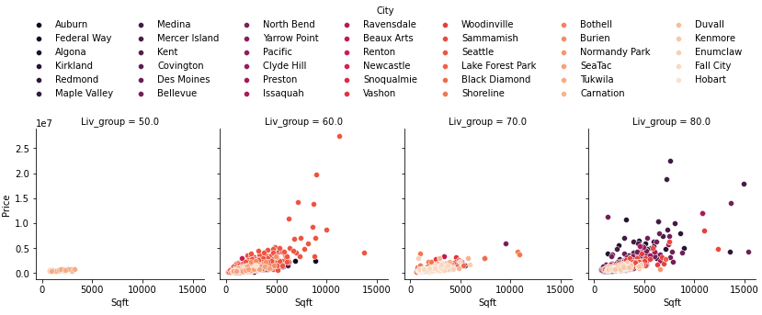
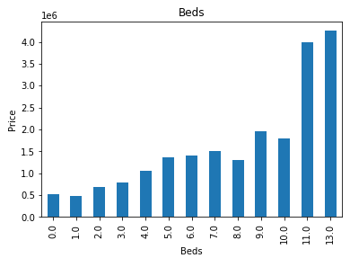
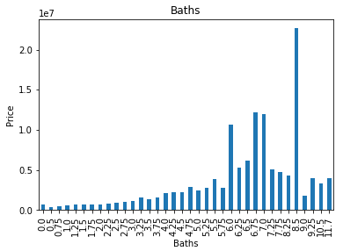
Seattle Housing Prices – Housing Data
Seattle metro area towns include the following segmented by livability index:

Slide 6
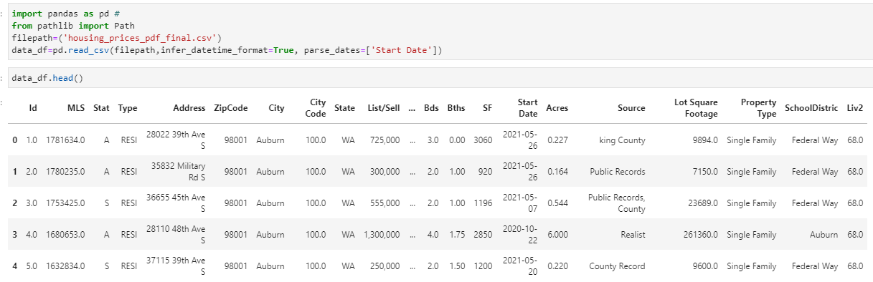
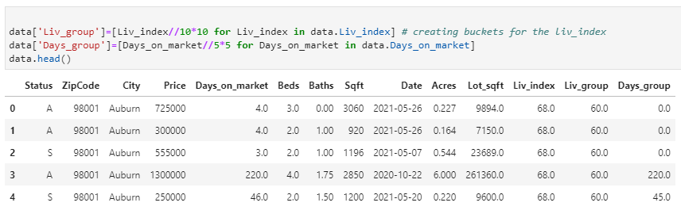
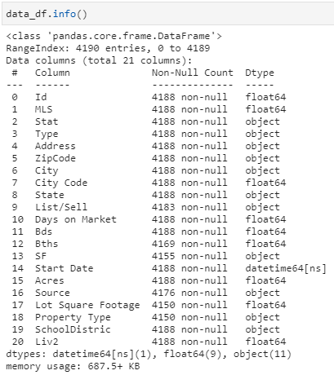
Seattle Housing Prices – Data Cleanup
Source data required PDF conversion and extensive cleaning to prep for machine learning

Slide 7
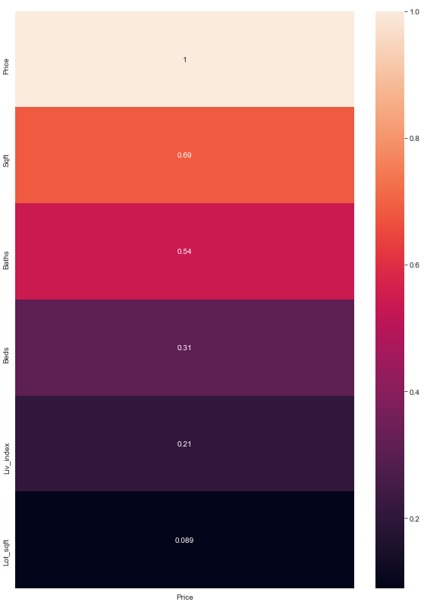
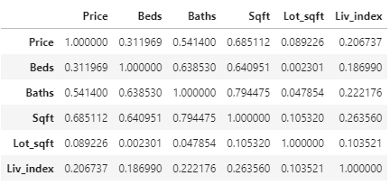
Seattle Housing Prices – Correlation
Calculated individual correlations of Seattle metropolitan area housing prices during April 2021 – May 2021 against the # of bedrooms, # of bathrooms, house sqft, lot sqft, and Livability Index
Identified the metrics with the highest correlation to housing prices
High correlation amongst housing prices are house sqft (0.69), # of baths (0.54), and # of bedrooms (.31)

Slide 8
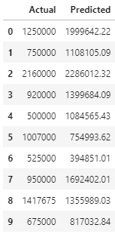
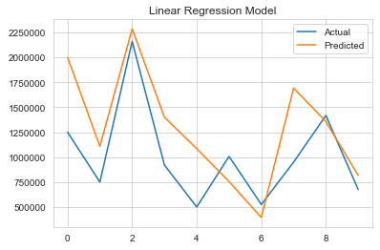
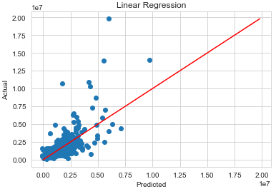
Seattle Housing Prices – Linear Regression
Calculated linear regression on identified metrics and housing prices
Linear Regression Equation
y = m(x) + b
m = coefficients
b = intercept
x = housing metrics
y = Estimated housing prices
r² = coefficient of determination (correlation squared)¹
Based on the linear regression methodology, the estimated linear equation is:
y = [-306,738*(# of beds)] + [77,541*(# of baths)] + [987,872*(house sqft)] - [3,002*(lot sqft)] + [41,363*(livability index)] + 1,185,934
Model error statistics:
Train Accuracy Score: 0.50
Test Accuracy Score: 0.50
Mean Absolute Error: 420,131.53
Mean Squared Error: 663,699,870,255.79
Root Mean Squared Error: 814,677.77

Slide 9
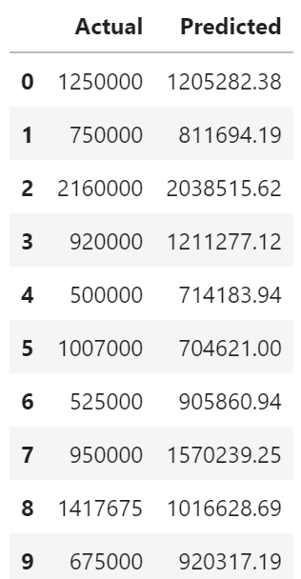
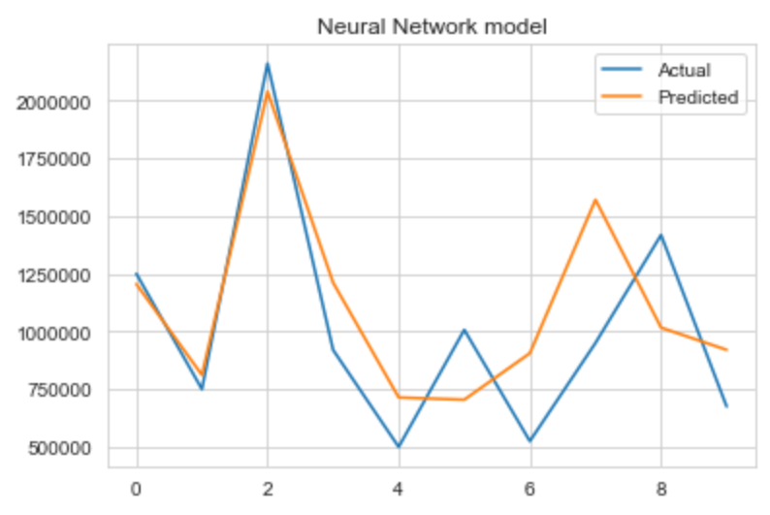
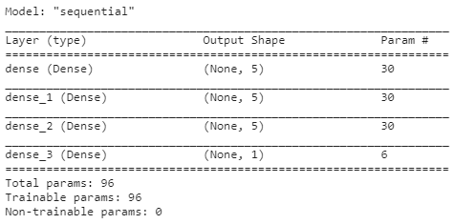
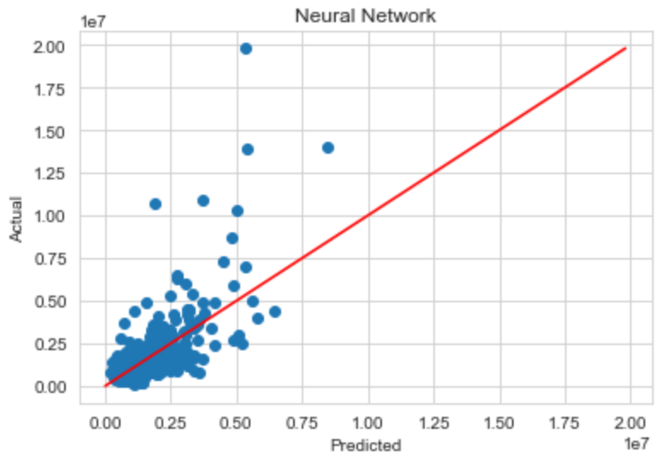
Seattle Housing Prices – Neural Network
Utilized neural network methodology on identified metrics and housing prices
Model error statistics:
Mean Absolute Error: 404,762.69
Mean Squared Error: 665,189,975,075.27
Root Mean Squared Error: 815,591.79
Batch size of 128 and 100 epochs

Slide 10
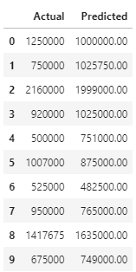
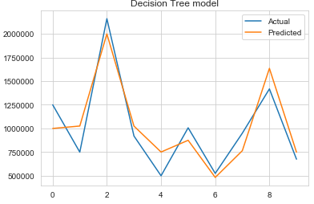
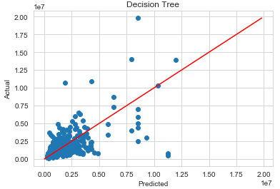
Seattle Housing Prices – Decision Tree
Utilized decision tree methodology on identified metrics and housing prices
Model error statistics:
Train Accuracy Score 1.00
Test Accuracy Score 0.35
Mean Absolute Error: 423,526.40
Mean Squared Error: 865,222,250,879.20
Root Mean Squared Error: 930,173.24

Slide 11
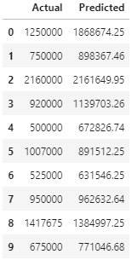
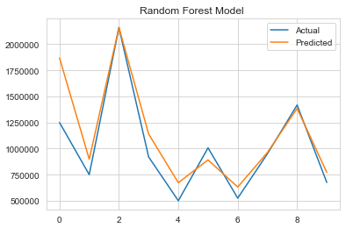
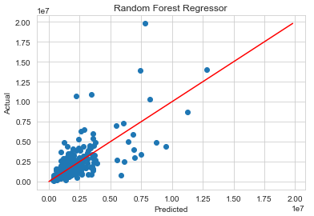
Seattle Housing Prices – Random Forest Regressor
Utilized random forest methodology on identified metrics and housing prices
Model error statistics:
Train Accuracy Score 0.93
Test Accuracy Score 0.58
Mean Absolute Error: 328,583.78
Mean Squared Error: 559,220,087,806.43
Root Mean Squared Error: 747,810.20

Slide 12
Seattle Housing Prices – Comparison
Based on the mean absolute error, mean squared error, and root mean squared error, the Random Forest methodology provided the most accurate housing price predictions for the selected metrics
 | Linear Regression | Neural Network | Decision Tree | Random Forest
Mean Absolute Error(MAE) | 420,132 | 404,763 | 423,526 | 328,584
Mean Squared Error(MSE) | 663,699,870,256 | 665,189,975,075 | 865,222,250,879 | 559,220,087,806
Root Mean Squared Error(RMSE) | 814,678 | 815,592 | 930,173 | 747,810
Accuracy Rank | #2 | #3 | #4 | #1

Slide 13
Seattle Housing Prices – Demonstration
Visual demonstration of how to estimate housing prices using the selected metrics using the tkinter graphical user interface
Imported new libraries
import tkinter as tk
from tkinter import scrolledtext
from tkinter.scrolledtext import

Slide 14
Seattle Housing Prices – Conclusion
All the machine learning methodologies generated significant errors when predicting housing prices based on the selected metrics
To better enhance the overall accuracy and reliability, additional data would be needed as our sample only provided 4,128 listed homes
Both additional amounts of data for the current selected metrics, but also incremental data types (i.e., the year when the house was built, recent renovations, pool, view, walkability score, driveway, size of garage, proximity of recent house foreclosures, etc. ).
Additional types of metrics would also better assist the machine learning methodologies, notably the neural networks

Slide 15

Questions

Slide 16
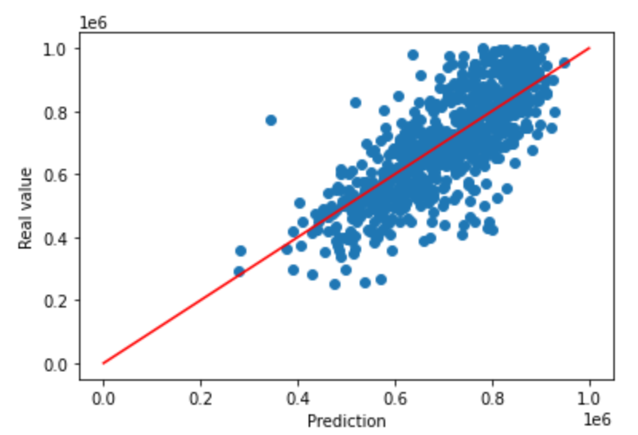
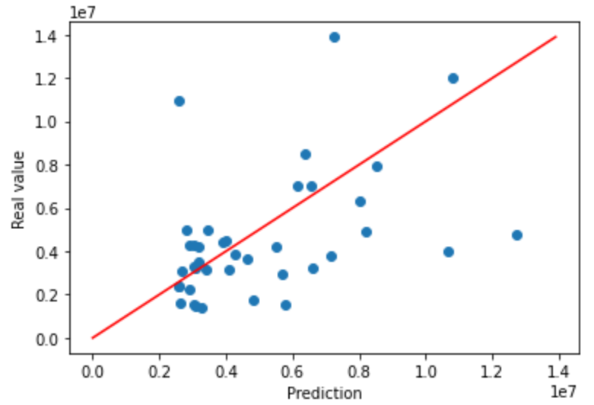
Appendix – Splitting the Housing Datasets
The housing data was bifurcated by housing prices above/below $1M to reduce the level errors
Model error statistics(<$1M):
Train Accuracy Score 0.94
Test Accuracy Score 0.60
Mean Absolute Error: 77,691.40
Mean Squared Error: 10,556,856,365.68
Root Mean Squared Error: 102,746.56
Model error statistics(>$1M):
Train Accuracy Score 0.89
Test Accuracy Score -0.05
Mean Absolute Error: 1,971,159.72
Mean Squared Error: 8,366,059,553,839.46
Root Mean Squared Error: 2,892,414.14

Slide 17
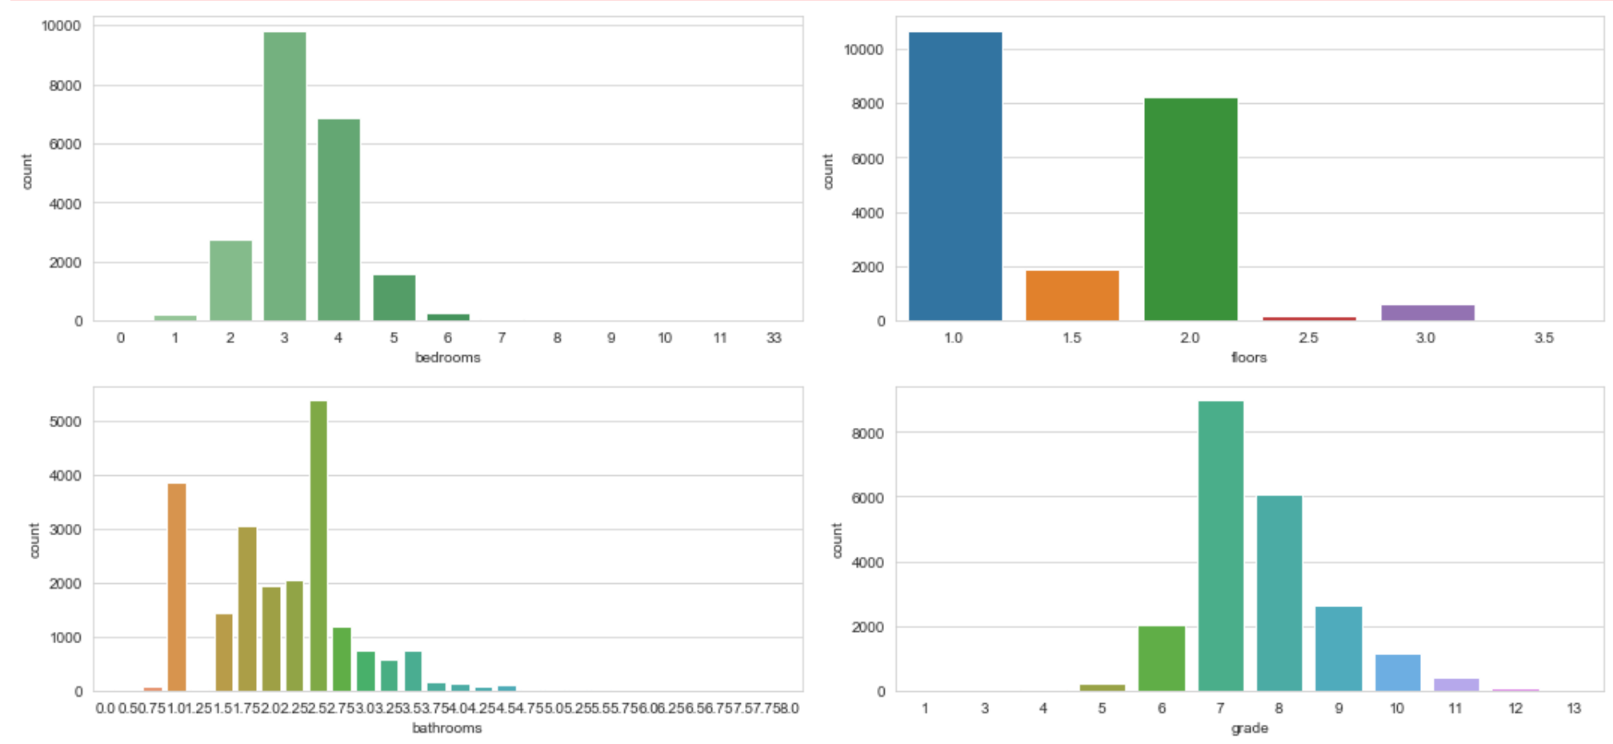
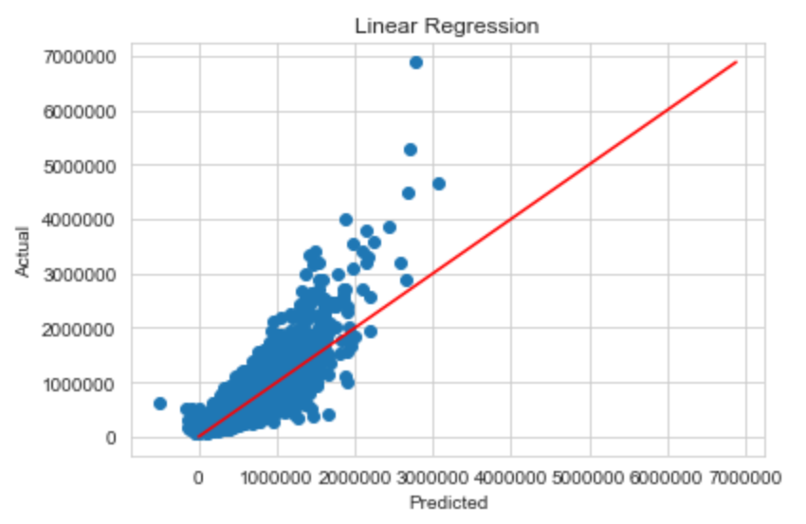
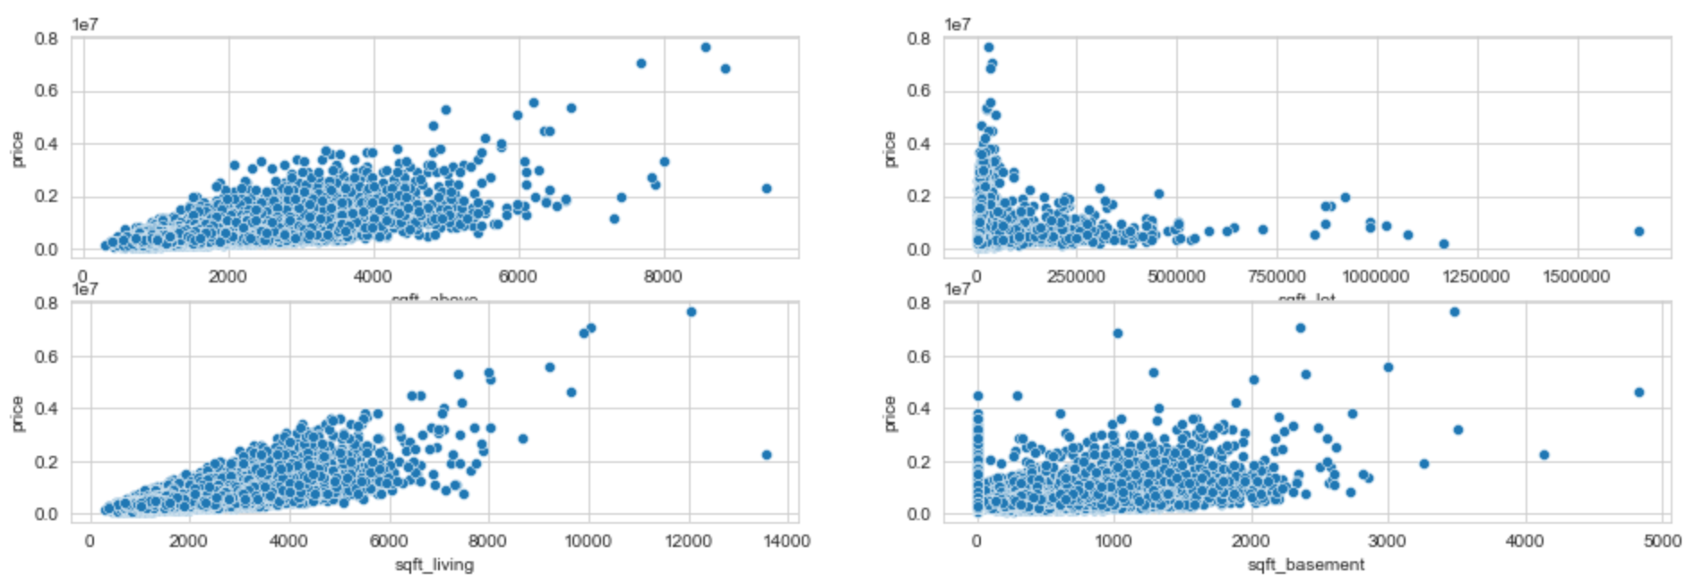
Appendix – Alternative Housing Data
Discovered alternative housing dataset of King County, WA from 2014 to 2015

